Slide 1


Learnwell Oy
VÅRDSVENSKA
PROJECT PRESENTATION

Slide 2
VÅRDSVENSKA – Swedish for Health Care Personnel
Vårdsvenska www.vardsvenska.fi is a language learning resource for health care personnel interested in learning Swedish:
Information about Finland in four languages – Swedish, English, Finnish and Russian
Language training (Swedish grammar explanations, material and exercises)
Tools for employment search and networking
Material (e.g. glossaries, worksheets, crosswords, etc)

Slide 3
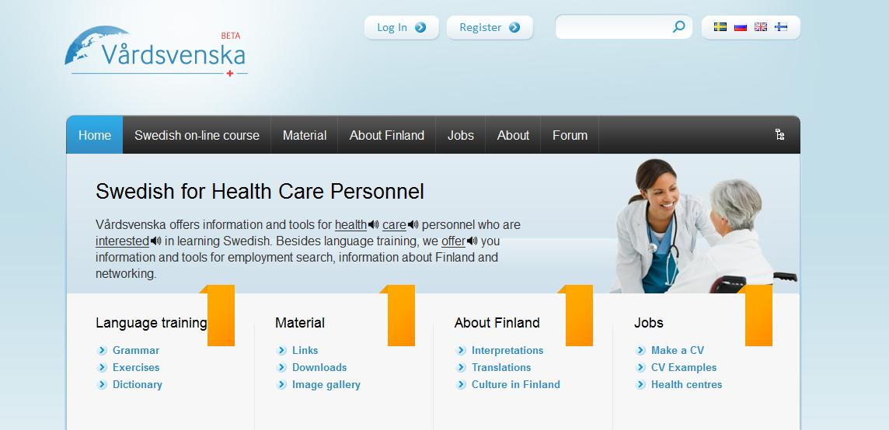
VÅRDSVENSKA – Swedish for Health Care Personnel
Vårdsvenska www.vardsvenska.fi

Slide 4
VÅRDSVENSKA – Swedish for Health Care Personnel
Networking:
Information about moving to Finland
Basic information on the country and culture
Contact details for government institutions, health care institutions, senior care homes, and much more

Slide 5
VÅRDSVENSKA – Swedish for Health Care Personnel
Jobs:
You can register as a user, open up a profile and create your CV online, save it in your profile, and send it straight through our site to any of the health care institutions in our database
Database with thousands of potential employers in Finland (hospitals, health care centres, dental offices, private healthcare institutions, etc.)
CV samples available

Slide 6
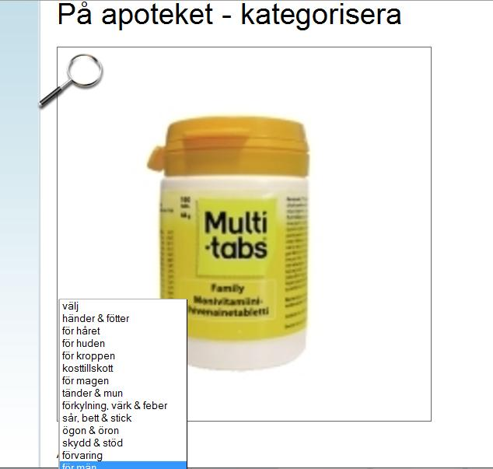
VÅRDSVENSKA – Swedish for Health Care Personnel
Language training:
The Swedish online course has information about Swedish vocabulary, pronunciation and the basic grammar
Hundreds of vocabulary and grammar exercises, picture exercises, reading and comprehension, related to the health care field and basic language exercises
The exercises are available in Swedish, Finnish, English and Russian, so you can practice the same vocabulary in four languages

Slide 7
VÅRDSVENSKA – Swedish for Health Care Personnel
Language training:
As a registered user, the programme keeps a log of your achievements
The difficulty level ranges from elementary to advanced
The “elderly care game” is a ten level interactive vocabulary and comprehension game. Upon completion of the last level, you will be able to print a certificate that confirms that you have completed the program. This will entitle you to attend an intensive course in conversational Swedish in Helsinki for free

Slide 8
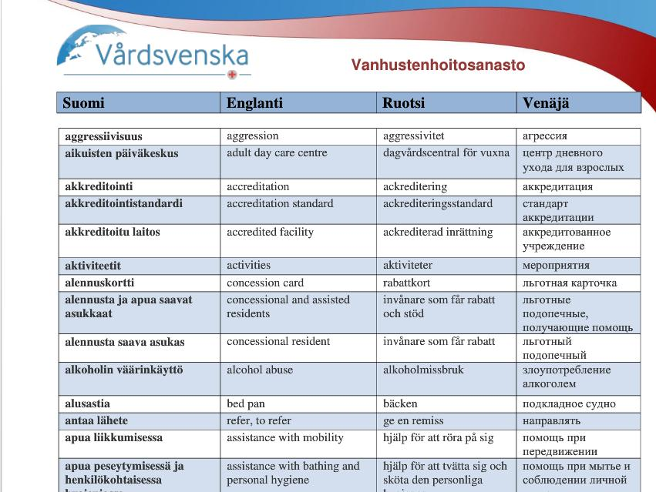
VÅRDSVENSKA – Swedish for Health Care Personnel
Material:
The material area contains the online material for self-study, a comprehensive image gallery, pronunciation and grammar explanations, downloadable vocabulary and grammar exercises, links and information
You can also download glossaries on many different subject areas related to health care (aged care, dental care, medical professions, diseases and symptoms, etc.), as well as every-day life
A dictionary with basic vocabulary and health care terminology in four languages

Slide 9

VÅRDSVENSKA – Swedish for Health Care Personnel
Vårdsvenska website is a unique tool for health care personnel
Learning Swedish can be fun!
Contact details:
Learnwell Oy, Mikonkatu 8 A, 00100 Helsinki, Finland office@learnwell.fi

